Slide 1

Project Title - Keystroke Logging Demonstration
VEDIKA NAIDU

Slide 2

PROBLEM STATEMENT
Monitoring user activity is important for security and analysis purposes.
Malicious keyloggers can capture sensitive information like passwords.
There is a need to understand how keyloggers work in order to detect and prevent them.
Demonstrating keylogging in a controlled environment helps in learning cybersecurity concepts safely.

Slide 3
Project Description • This project demonstrates how a keylogger captures keystrokes from a user. • The system records keyboard inputs and stores them in different formats. • Data can be stored as: - Text file - JSON format - GUI display • The project helps in understanding both the working and risks of keylogging.

Slide 4

WHO ARE THE END USERS?
Cybersecurity Students
Ethical Hackers
Researchers
Software Developers
IT Security Professionals

Slide 5

Technology Used
Python Programming Language
Libraries:
pynput (for capturing keystrokes)
json (for storing data)
tkinter (for GUI)
File Handling (Text & JSON)
Desktop Environment

Slide 6
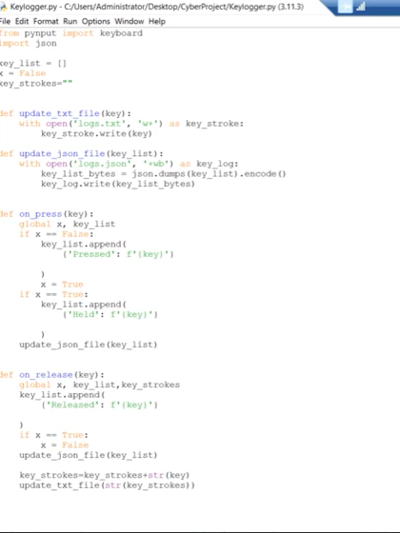
RESULTS
Demo Link

Slide 7
Thank you
.
.

